Slide 1
Week 1
Introduction to the web:
The Environment and the Tools
WEEK 1

Slide 2
Week 1 Lecture
Introduction to ICT114 Web Development
Describe the Internet, the World Wide Web and ways to access it
Categorize types of websites
Identify web design tools
Explain web design principles, roles, and required skills
Ethics in web design

Slide 3
ICT114 Web Development
Focus on practical applications of theory.
Interactive learning, short lecture segments interspersed with hands on work/experimentation and class discussions.
Class participation (discussions, tutorial activities, …) is assessed.
No prescribed textbook due a constantly changing landscape.
Class attendance is very important – if you do not attend a class you will have to catch up on your own, which is a lot more work!

Slide 4
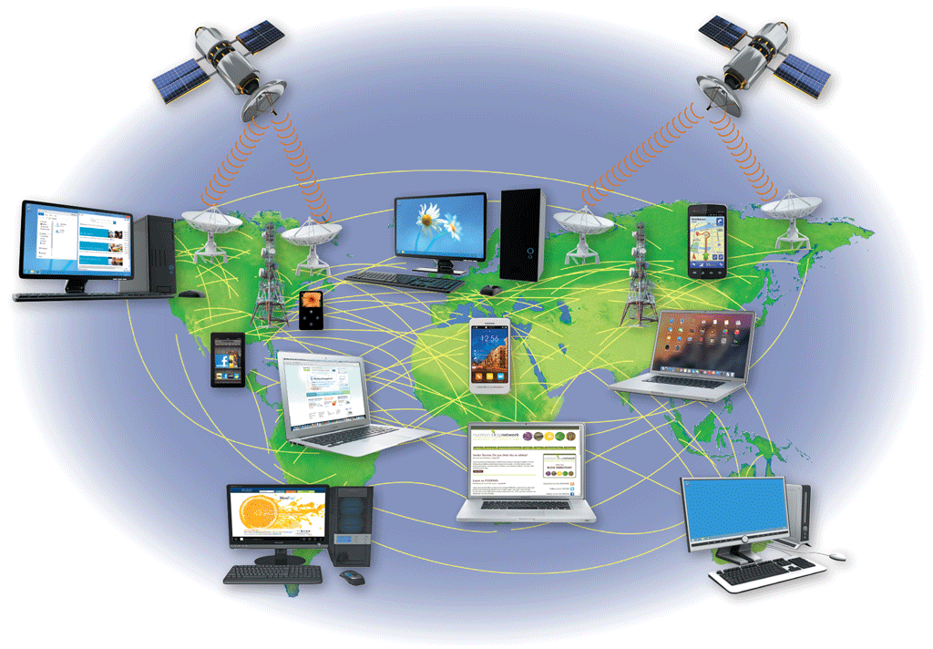
The Internet and the World Wide Web (WWW.. Net.. web)
A computer network consists of connected computers, mobile devices, printers, and data storage devices that share computing resources and data
The Internet is a worldwide public network that connects millions of these private networks

Slide 5
The Internet and the World Wide Web
The World Wide Web (WWW or web) is a part of the Internet that consists of connected computers called web servers that store electronic documents called webpages.
A webpage is a specially formatted document that can contain images, text, interactive elements, and hyperlinks, which are links to other pages
A website is a group of related webpages

Slide 6
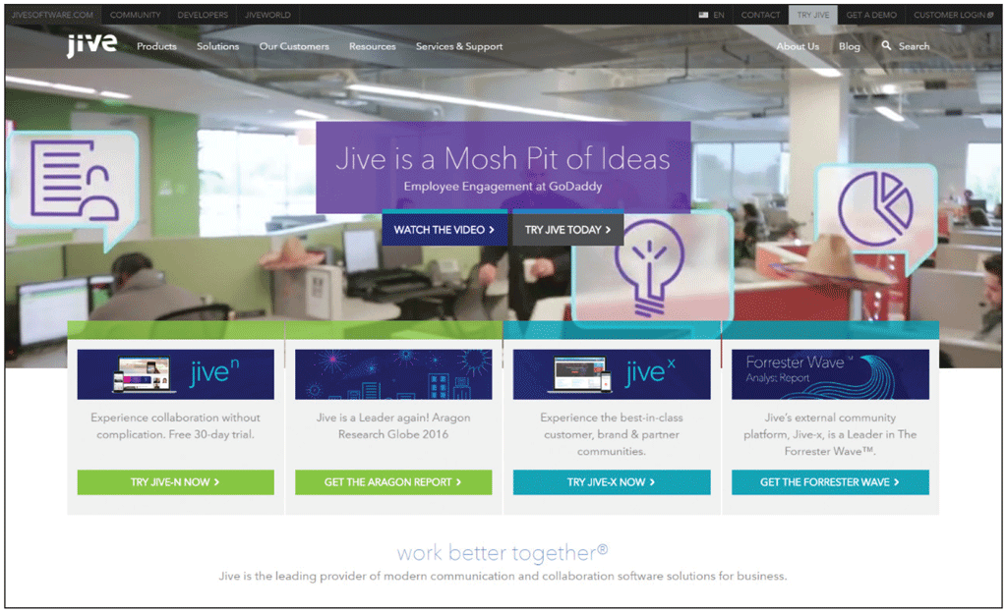
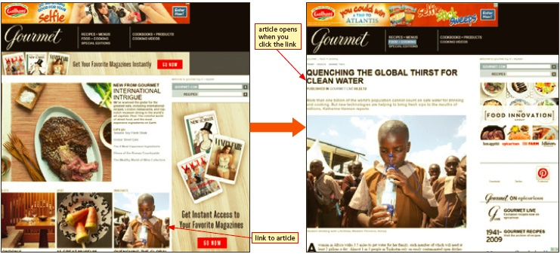
World Wide Web (WWW or Web)
A website’s primary page is its home page
Browsing or surfing the web is exploring the web by moving from one webpage to another

Slide 7
Influence on Society
Communication
Education
Entertainment and News
E-commerce

Slide 8
Communication
Bookmark / favorite
Shortcut
Internet Relay Chat (IRC)
Web chat
Instant messaging / IM chat
Group messaging apps
Collaborative workspaces / virtual meeting spaces
Blog
Video sharing / Video blogging
Social networking
Social bookmarking
Massively multiplayer online games (MMOGs)
3D virtual worlds
Wiki

Slide 9
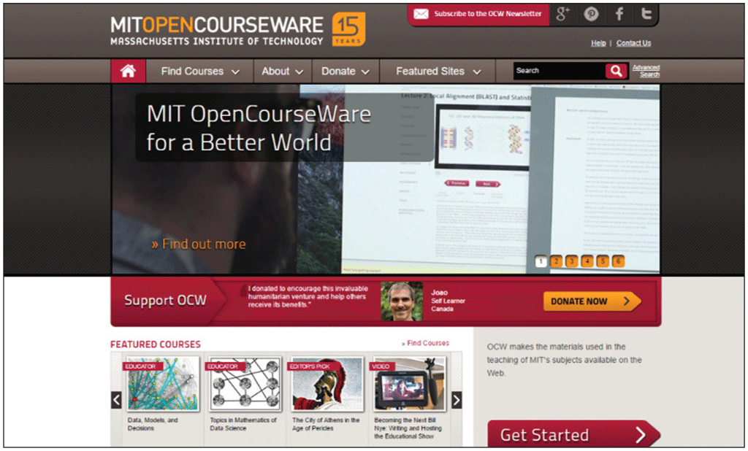
Education
Take an online course from an academic institution to earn a degree or certificate
Watch a video or read a blog post by an amateur expert
Several universities and academic institutions publish some or all educational materials online

Slide 10
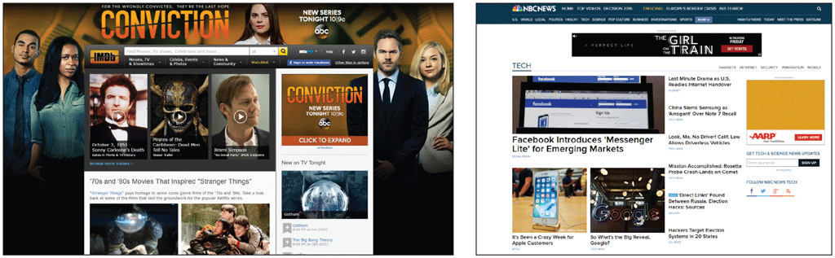
Entertainment and News
Popular entertainment sites include music, videos, sports, games, and more
News websites allow you to read news stories, and some even allow you to watch video clips
Some provide interactive elements

Slide 11
E-Commerce
Electronic commerce or e-commerce encompasses a wide variety of online business activities, including consumer shopping and investing and the exchange of business data and transactions within a company or among multiple companies
Business-to-consumer (B2C)
Business-to-business (B2B)
Consumer-to-consumer (C2C)

Slide 12
Ways to Access the Internet
The speed at which data travels from one device to another is the transfer rate
Bits per second (bps)
From thousands (kbps) to millions (Mbps)
Higher-quality connections needed for streaming media

Slide 13
Broadband Connections
Broadband defines high-speed data transmissions over a communications channel that can transmit multiple signals at one time
Digital subscriber line (DSL)
Cable television (CATV) line
FTTP: Fiber to the Premises
Satellite

Slide 14
Connecting to the Internet and the Web
Mobile wireless technologies:
Radio signals
Wi-Fi (wireless fidelity)
Cellular telephones
Wireless providers’ broadband networks
Generations classify standards for mobile communications:
3G: speech and data services
4G: gaming apps and streaming media

Slide 15
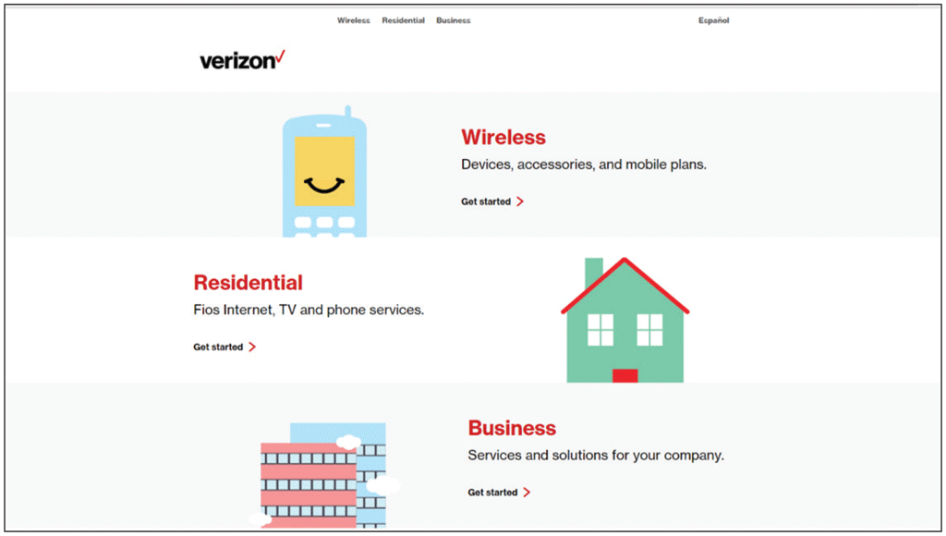
Internet Service Provider (ISP)
Has permanent Internet connection
Provides temporary connections
Regional ISP
National ISP
Telstra , Optus, TPG

Slide 16
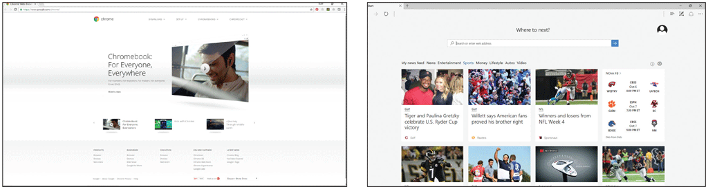
Web Browsers
A program or app that requests, downloads, and displays webpages stored on a web server
Examples
Google Chrome
Microsoft Edge
Mozilla Firefox

Slide 17
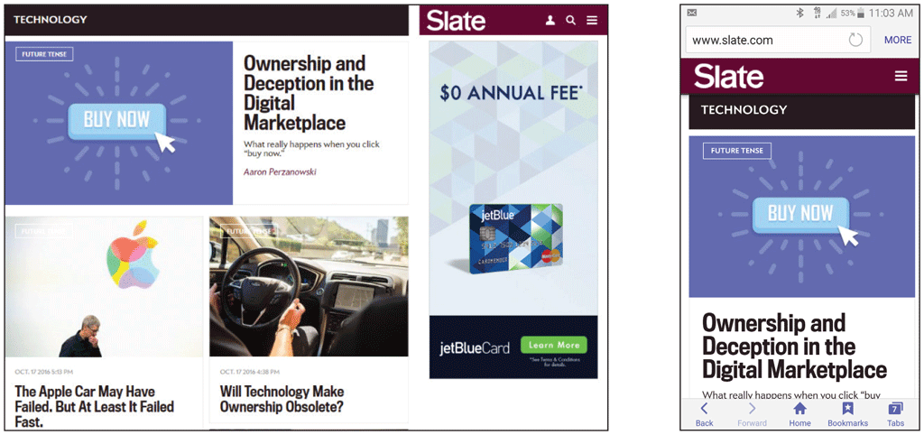
Web Browsers
Responsive web design (RWD) is used to create websites that adjust to the device and screen size displaying the webpage

Slide 18
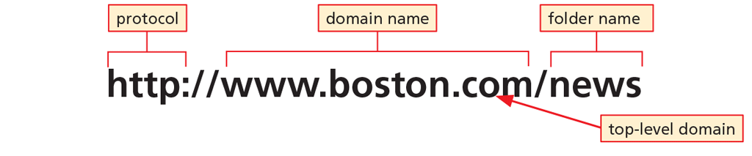
Web Browsers
Access webpages by entering its Uniform Resource Locator (URL) into the browser’s Address bar
URL is comprised of the protocol, domain name and top-level domain designation
Hypertext Transfer Protocol (HTTP)
Domain name can be an IP address or a text version of this address

Slide 19
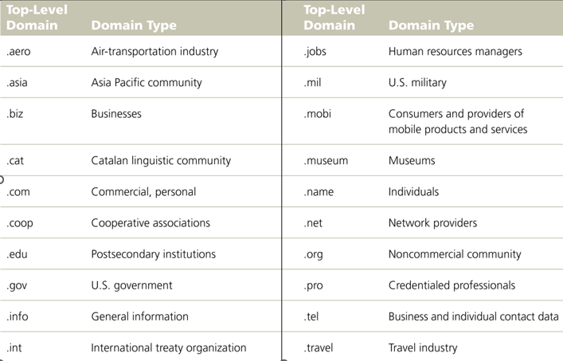
Web Browsers

Slide 20
Types of Websites
Personal
Organizational / Topical
Commercial

Slide 21
Personal
Limited developmental resources
Content management systems
Uses:
Promote employment credentials
Share news and photos with friends and family
Share common interests or hobbies
Do not post information that can be misused

Slide 22
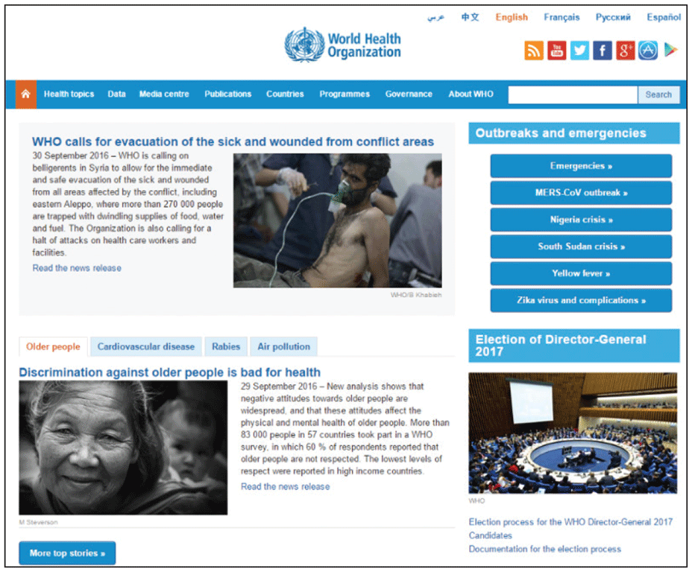
Organizational / Topical
Organizational websites contain information on particular organizations
Topical websites focus on a specific subject

Slide 23
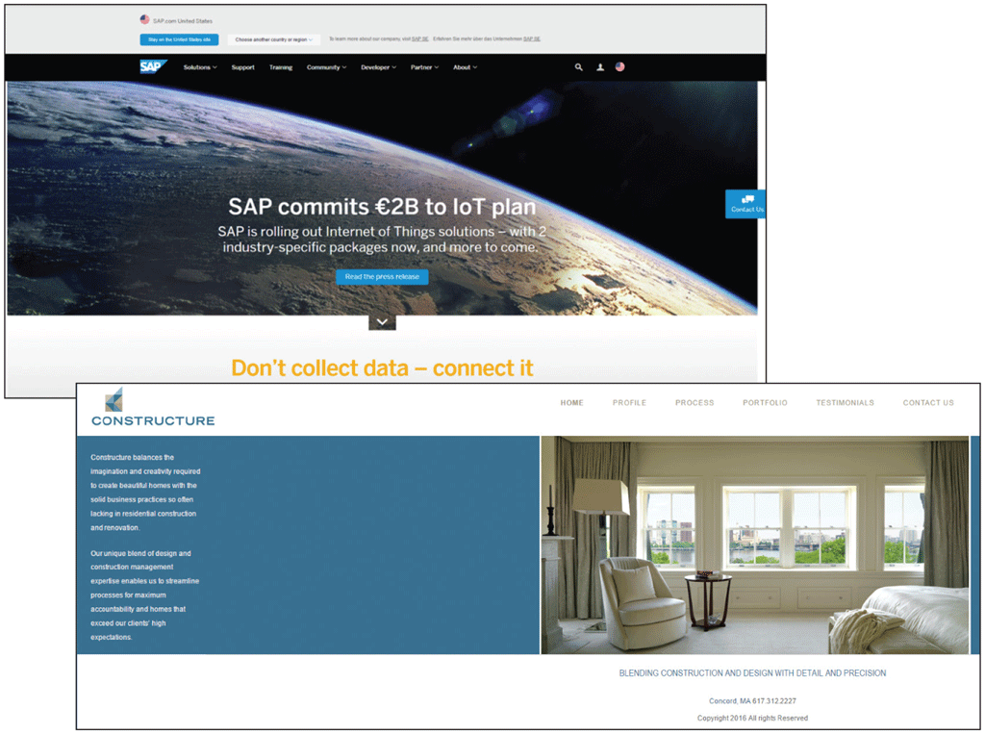
Commercial
Used to promote and sell a product or service
More sophisticated commercial websites generally produce greater revenue

Slide 24
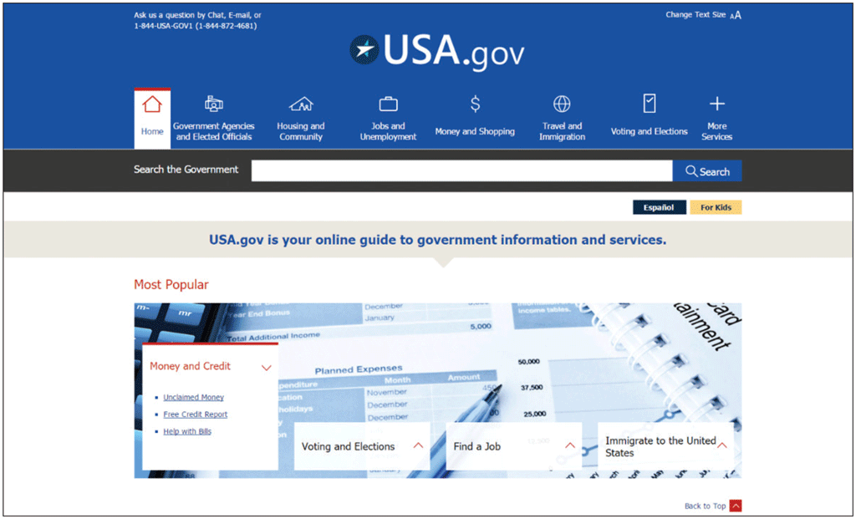
Portals
A portal is a website that offers a starting point for accessing information
General consumer
Personal
Vertical
Corporate

Slide 25
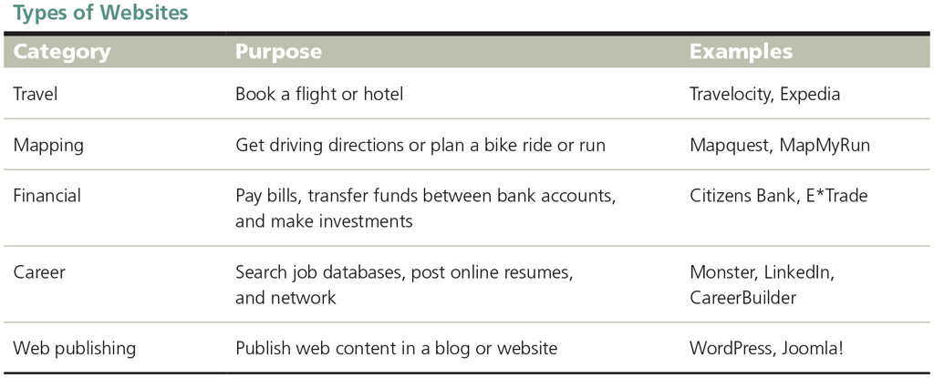
Other Types of Websites

Slide 26
Web Design Tools
Before adding new technology, ask:
Does it meet currently accepted standards?
What can it do to further my purpose?
How will it affect my website’s visual appeal, accessibility, and usability?
What impact will it have on security and other website elements?
What are the direct and indirect costs?
How soon will I see a return on investing?

Slide 27
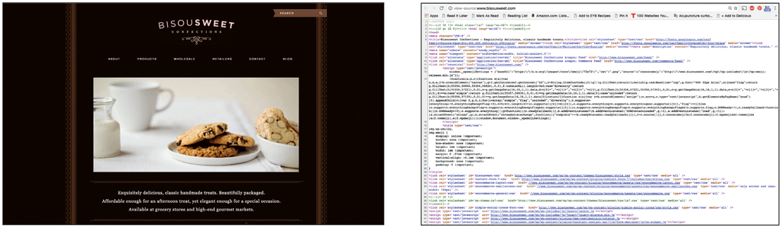
Markup Languages
Hypertext Markup Language (HTML)
Uses tags to define format and organization of webpage elements
HTML5
W3C sets standards
Extensible Markup Language (XML)
Facilitates sharing of information

Slide 28
Cascading Style Sheets (CSS)
Standardize the presentation of the content by applying styles to such elements
Font
Margins
Positioning
Background colors
Style sheets can be attached to multiple webpages

Slide 29
Scripting Languages
Programming languages used to write short programs that run on the server or the browser
Javascript
PHP: Hypertext Preprocessor (PHP)
CoffeeScript
Active content
Malware

Slide 30
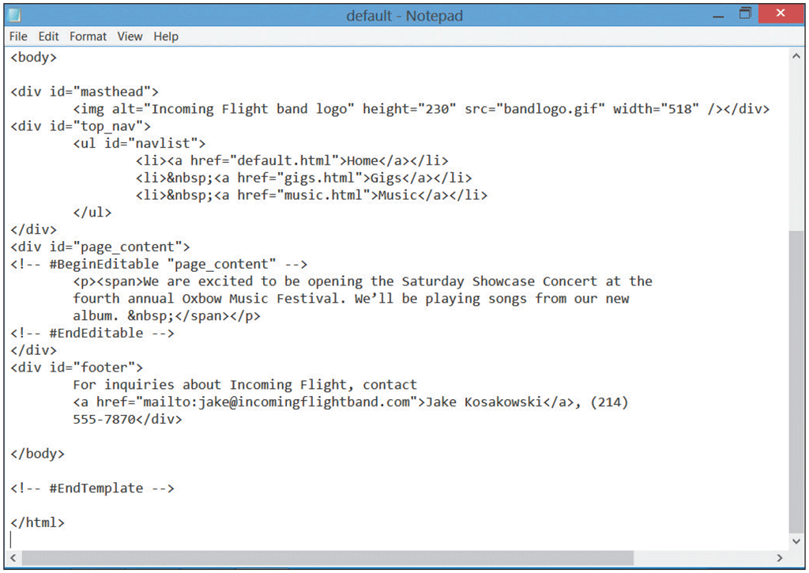
Text and HTML Editors
A text editor is software used to create plain (ASCII) text files
An HTML editor is a text editor enhanced with special features that are used to more easily insert HTML tags and their attributes
HTML-Kit
CoffeeCup
BBEdit
NoteTab
NotePad++

Slide 31
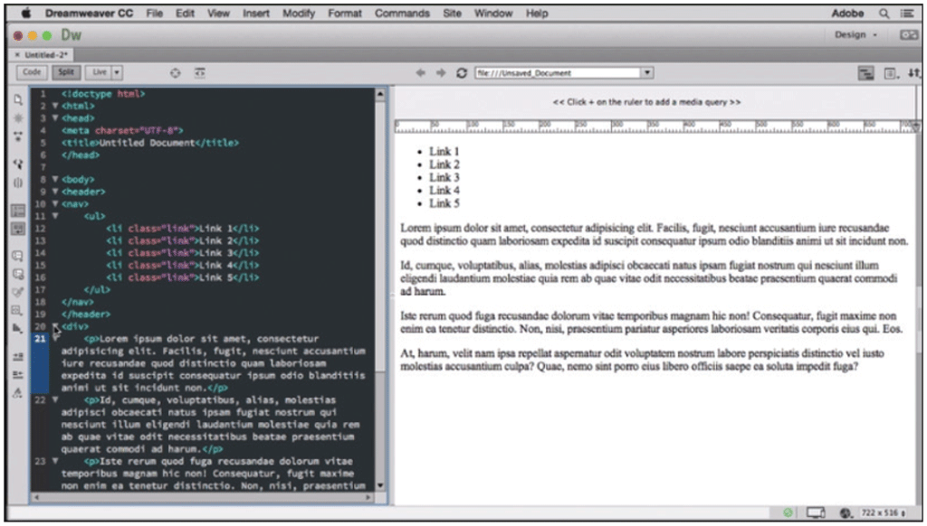
Web Development Tools
Packages that automatically generate HTML code
WYSIWYG
IDEs
Challenges to using web development tools:
Might look different than what you see in browser
Unnecessary codes create large, slow-loading webpages
Might not use latest markup language standards

Slide 32
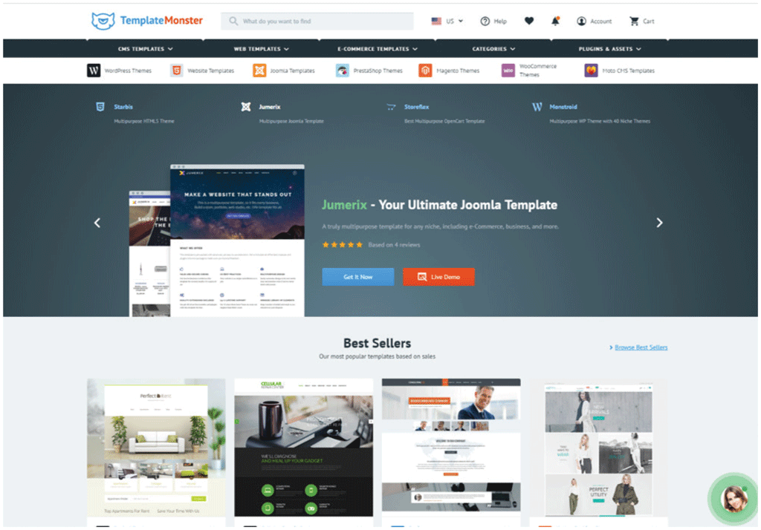
Web Templates and Content Management Systems
A Web template or theme is a predesigned model that can be customized for fast website or webpage creation or updating
A content management system (CMS) facilitates the management of web content development
Drupal
WordPress
Joomla
Content repository
Notes:
An intranet is a private network within a large organization or commercial entity that uses Internet and web technologies to share information among only its members, employees, or business partners

Slide 33
Web Design Roles
Creative
Technical
Oversight

Slide 34
Web Design Roles
Creative Roles
Content writer / editor
SEO expert
Web designer
UI / UX manager
Web artist / graphic designer
Multimedia producer

Slide 35
Web Design Roles
Technical Roles
Web programmer / developer
Front-end
Back-end
Full-stack
Database developer
Web server administrator

Slide 36
Web Design Roles
Oversight Roles
Web administrator
System architect
Tester
Social media expert

Slide 37

Legal and Ethical Issues in Web Design
What is ethics?
Standards of moral conduct
Standards of right and wrong behaviour
A gauge for personal integrity
The basis of trust and cooperation in relationships with others

Slide 38
Ethics in Web Design
Why do you have to learn about ethics?
Employers require that students understand the ethical implications of design and decision-making (including how to deal with gray areas).
There are a lot of interesting related topics, like intellectual property (e.g. copyrights), privacy and security, etc.
We trade in digital information (from images and music to source code); there are many implications, such as what can be copied freely.
Software has a real impact on people. There can be consequences of software we design and programs we write, based on how they affect users, as well as others. (e.g. in terms of safety, privacy...)

Slide 39
Ethics in Web Design
Misleading interfaces
Also known as dark patterns
Deceptive web design tactics for tricking users into unintended actions such as making purchases or sharing data, for business gain.
Examples of dark patterns: misdirection which highlights irrelevant features to obscure critical details; Roach Motel, makes it easy to sign-on to something but impossible to cancel; sneak into basket which adds items without user consent.

Slide 40
Lecture Summary
Describe the Internet and the World Wide Web
Discuss ways to access the Internet and the web
Categorize types of websites
Identify web design tools
Explain web design principles, roles, and required skills
Ethics in web design

Slide 41
Next Weeks Lecture
HTML5, CSS3 a more detailed look at creating a webpage.

